Slide 1
Module 1: The Basics of Input-Output Analysis 2.3 Input-Output Models: Linkages and Multipliers
April 2025

Slide 2
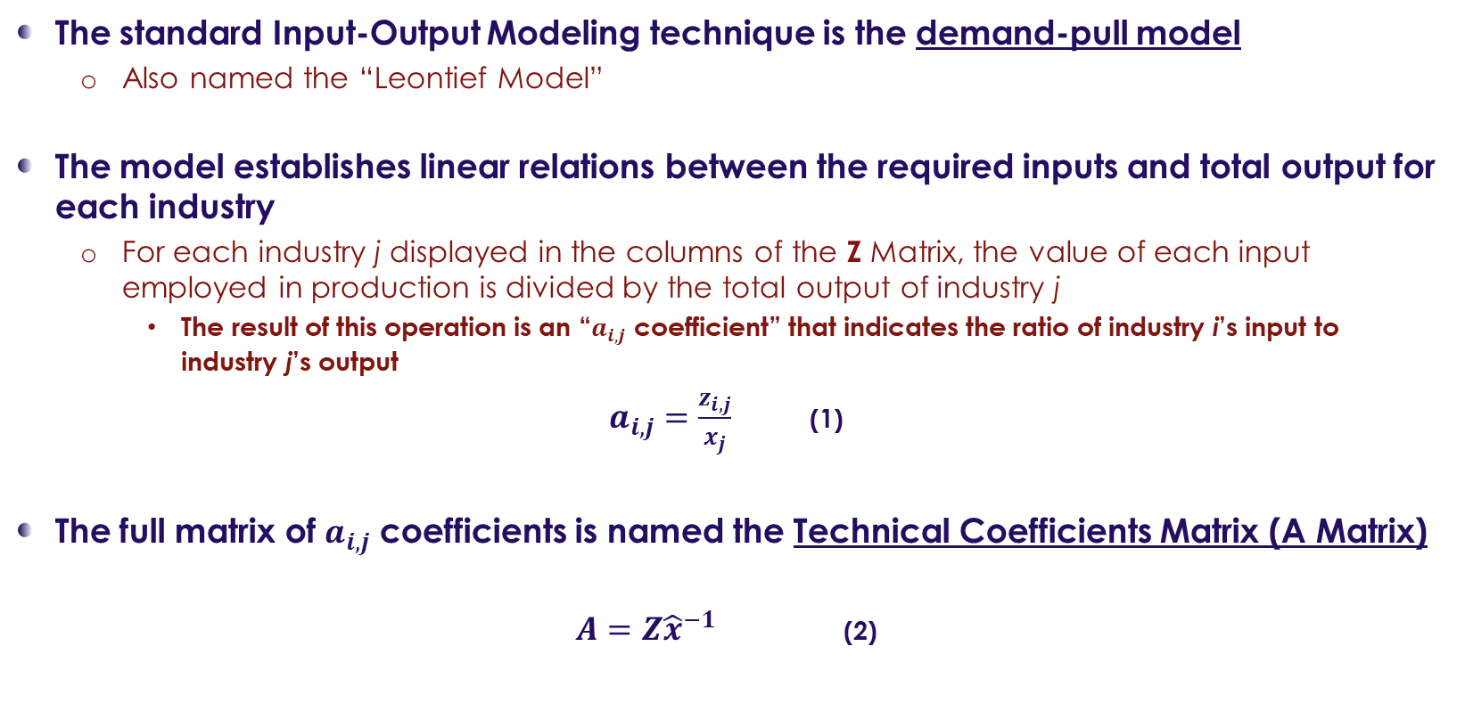
Input-Output Models: Linkages and Multipliers
Technical Coefficients Matrix (A Matrix)
The standard Input-Output Modeling technique is the demand-pull model
Also named the “Leontief Model”
The model establishes linear relations between the required inputs and total output for each industry
For each industry j displayed in the columns of the Z Matrix, the value of each input employed in production is divided by the total output of industry j
The result of this operation is an “$a_{i,j}$ coefficient” that indicates the ratio of industry i’s input to industry j’s output
$a_{i,j}=\frac{z_{i,j}}{x_{j}}$ (1)
The full matrix of $a_{i,j}$ coefficients is named the Technical Coefficients Matrix (A Matrix)
$A=Z{\hat{x}}^{−1}$ (2)

Slide 3

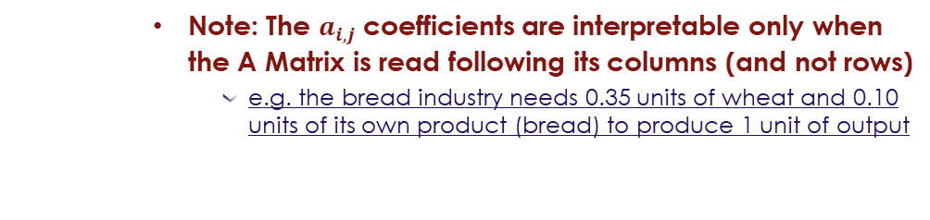

Input-Output Models: Linkages and Multipliers
Technical Coefficients Matrix (A Matrix)
Let’s go back to our example and calculate its Technical Coefficients Matrix:
The A Matrix will be calculated as follows:
 | Wheat | Bread | Final Demand | Total Output
Wheat | 30 | 70 | 0 | 100
Bread | 0 | 20 | 180 | 200
Imports | 10 | 10 | 70 | -
Value Added (Factors’ of Production Remuneration) | 60 | 100 | =
Total Output | 100 | 200 |  | 300
 | Wheat | Bread
Wheat | 30/100 = 0.30 | 70/200 = 0.35
Bread | 0/100 = 0.00 | 20/200 = 0.10
Note: The $a_{i,j}$ coefficients are interpretable only when the A Matrix is read following its columns (and not rows)
e.g. the bread industry needs 0.35 units of wheat and 0.10 units of its own product (bread) to produce 1 unit of output

Slide 4
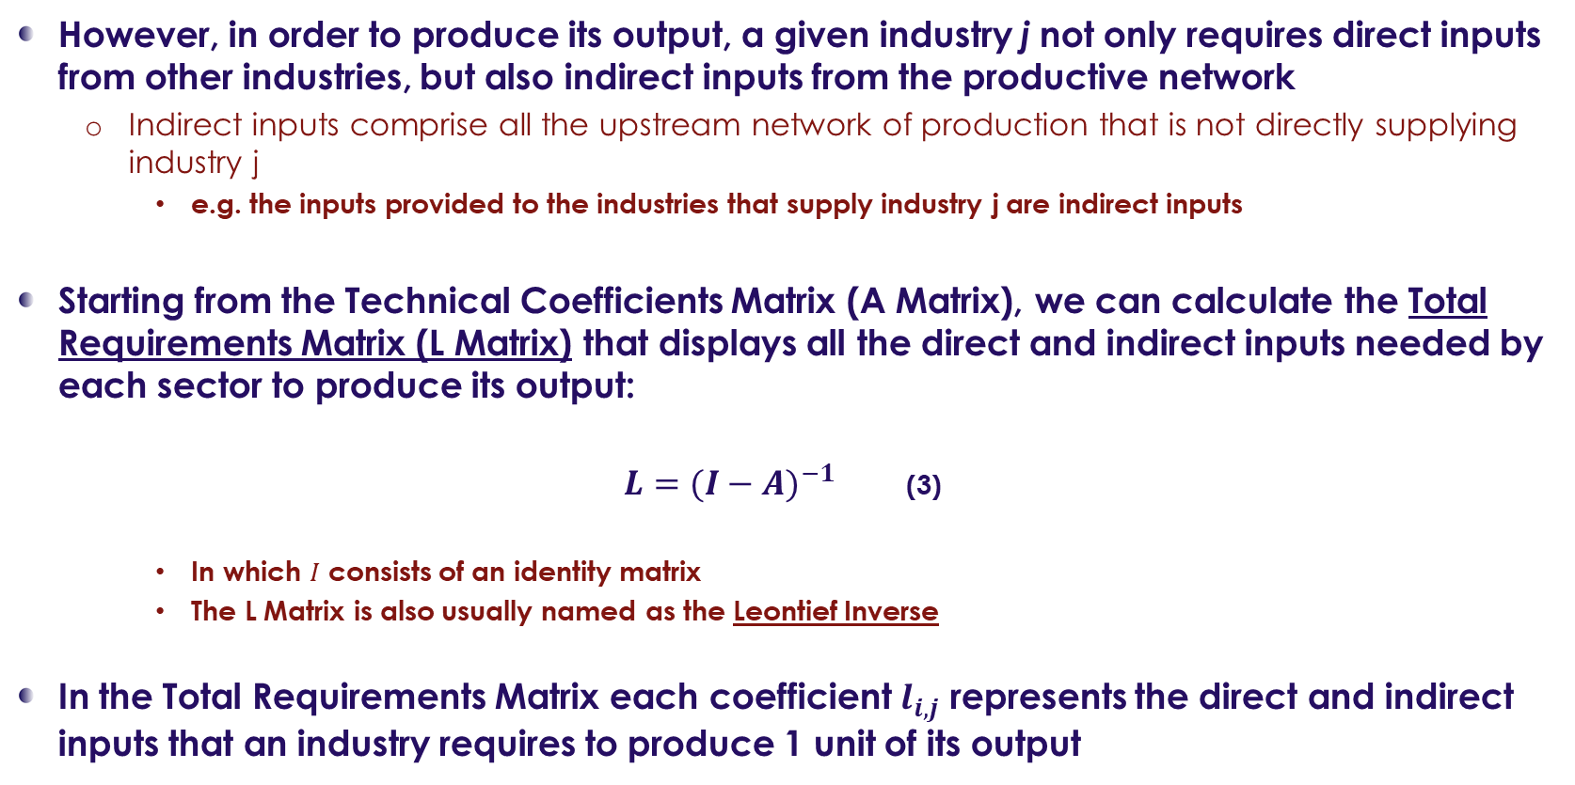
Input-Output Models: Linkages and Multipliers
Total Requirements Matrix (L Matrix)
However, in order to produce its output, a given industry j not only requires direct inputs from other industries, but also indirect inputs from the productive network
Indirect inputs comprise all the upstream network of production that is not directly supplying industry j
e.g. the inputs provided to the industries that supply industry j are indirect inputs
Starting from the Technical Coefficients Matrix (A Matrix), we can calculate the Total Requirements Matrix (L Matrix) that displays all the direct and indirect inputs needed by each sector to produce its output:
$L={(I−A)}^{−1}$ (3)
In which $I$ consists of an identity matrix
The L Matrix is also usually named as the Leontief Inverse
In the Total Requirements Matrix each coefficient $l_{i,j}$ represents the direct and indirect inputs that an industry requires to produce 1 unit of its output

Slide 5
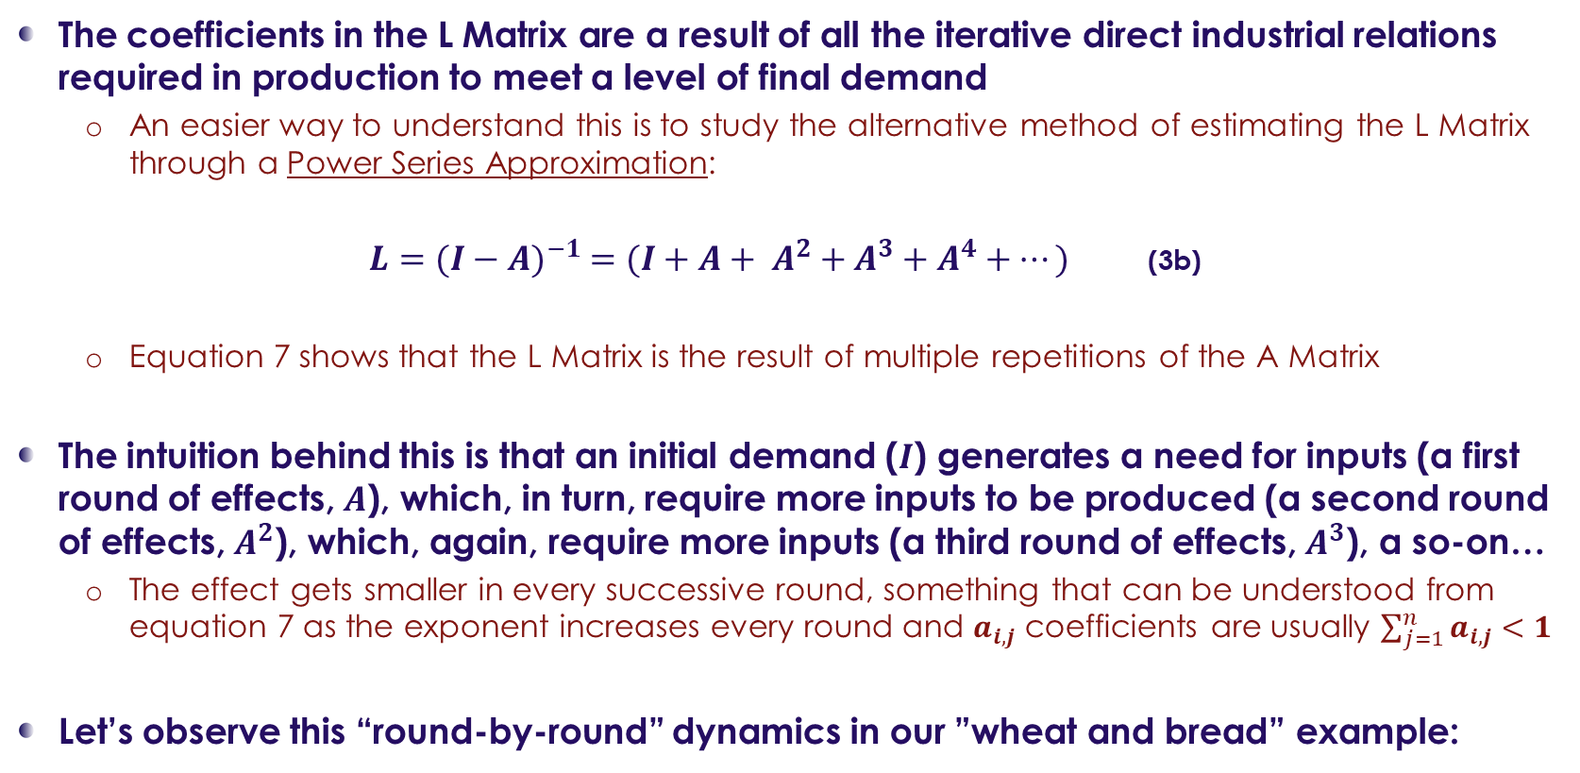
Input-Output Models: Linkages and Multipliers
Understanding the connection between A and L Matrices
The coefficients in the L Matrix are a result of all the iterative direct industrial relations required in production to meet a level of final demand
An easier way to understand this is to study the alternative method of estimating the L Matrix through a Power Series Approximation:
$L={(I−A)}^{−1} =(I+A+ A^{2}+A^{3}+A^{4}+⋯)$ (3b)
Equation 7 shows that the L Matrix is the result of multiple repetitions of the A Matrix
The intuition behind this is that an initial demand ($I$) generates a need for inputs (a first round of effects, $A$), which, in turn, require more inputs to be produced (a second round of effects, $A^{2}$), which, again, require more inputs (a third round of effects, $A^{3}$), a so-on…
The effect gets smaller in every successive round, something that can be understood from equation 7 as the exponent increases every round and $a_{i,j}$ coefficients are usually $\sum_{j=1}^{n}{a_{i,j}}<1$
Let’s observe this “round-by-round” dynamics in our ”wheat and bread” example:

Slide 6

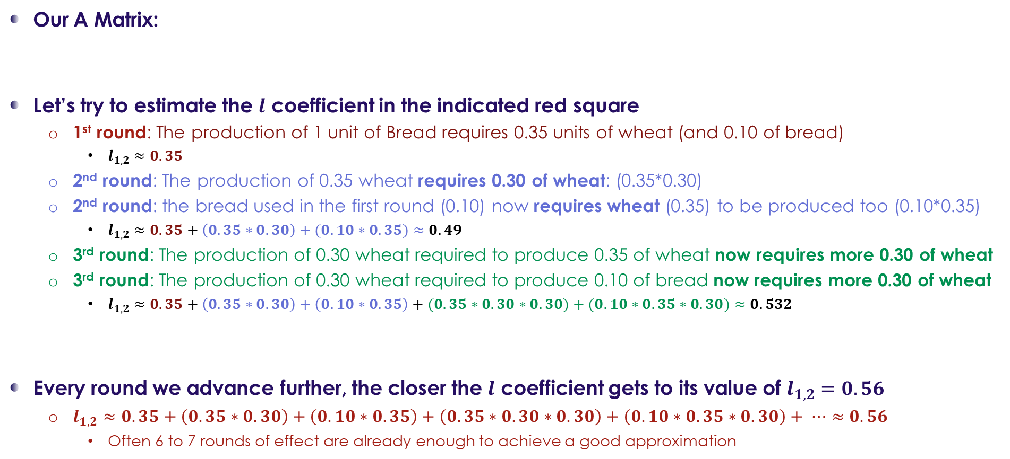
Input-Output Models: Linkages and Multipliers
Understanding the connection between A and L Matrices
 | Wheat | Bread
Wheat | 0.30 | 0.35
Bread | 0.00 | 0.10
Our A Matrix:
Let’s try to estimate the $l$ coefficient in the indicated red square
1st round: The production of 1 unit of Bread requires 0.35 units of wheat (and 0.10 of bread)
$l_{1,2}≈0.35$
2nd round: The production of 0.35 wheat requires 0.30 of wheat: (0.35*0.30)
2nd round: the bread used in the first round (0.10) now requires wheat (0.35) to be produced too (0.10*0.35)
$l_{1,2}≈0.35+\left(0.35∗0.30\right)+(0.10∗0.35)≈0.49$
3rd round: The production of 0.30 wheat required to produce 0.35 of wheat now requires more 0.30 of wheat
3rd round: The production of 0.30 wheat required to produce 0.10 of bread now requires more 0.30 of wheat
$l_{1,2}≈0.35+\left(0.35∗0.30\right)+\left(0.10∗0.35\right)+(0.35∗0.30∗0.30)+(0.10∗0.35∗0.30)≈0.532$
Every round we advance further, the closer the $l$ coefficient gets to its value of $l_{1,2}=0.56$
$l_{1,2}≈0.35+\left(0.35∗0.30\right)+\left(0.10∗0.35\right)+\left(0.35∗0.30∗0.30\right)+\left(0.10∗0.35∗0.30\right)+ ⋯≈0.56$
Often 6 to 7 rounds of effect are already enough to achieve a good approximation
1st round
2nd round (0.19)
3rd round (0.042)

Slide 7
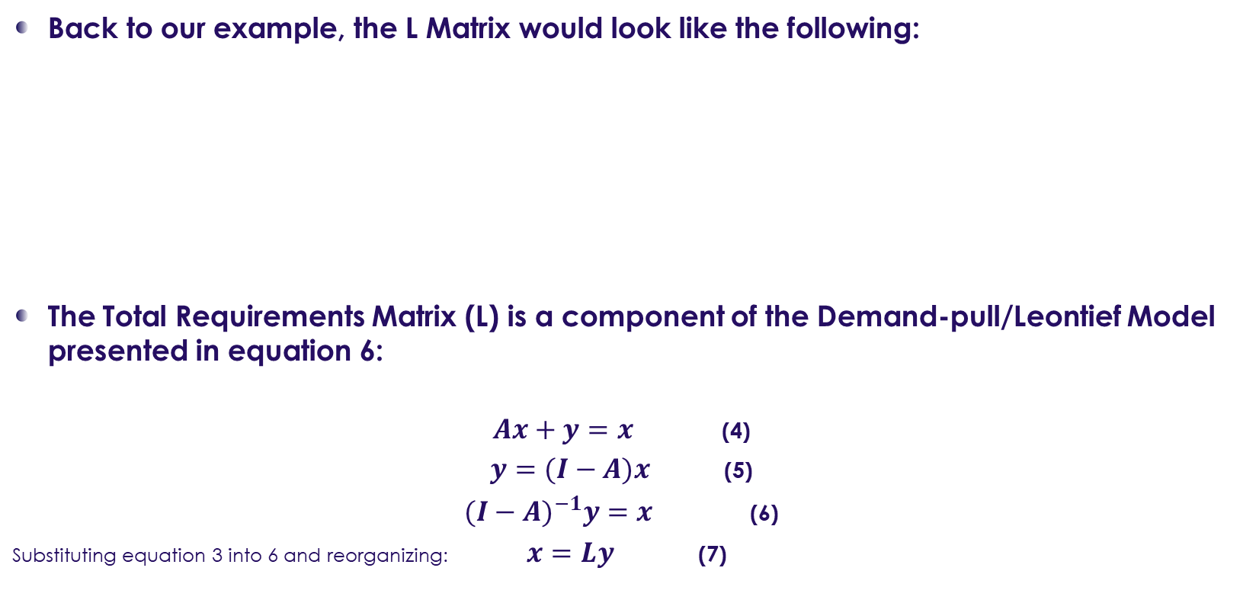
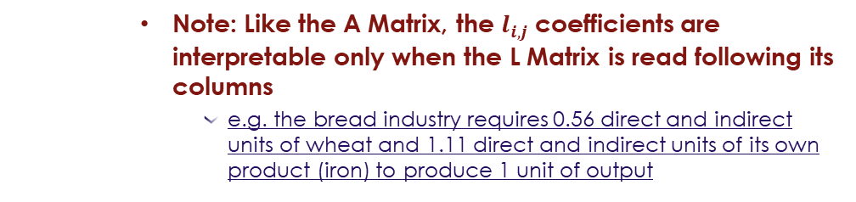
Input-Output Models: Linkages and Multipliers
The Demand-pull/Leontief Model
Back to our example, the L Matrix would look like the following:
The Total Requirements Matrix (L) is a component of the Demand-pull/Leontief Model presented in equation 6:
$Ax+y=x$ (4)
$y=(I−A)x$ (5)
${(I−A)}^{−1}y=x$ (6)
Substituting equation 3 into 6 and reorganizing: $x=Ly$ (7)
 | Wheat | Bread
Wheat | 1.43 | 0.56
Bread | 0 | 1.11
Note: Like the A Matrix, the $l_{i,j}$ coefficients are interpretable only when the L Matrix is read following its columns
e.g. the bread industry requires 0.56 direct and indirect units of wheat and 1.11 direct and indirect units of its own product (iron) to produce 1 unit of output

Slide 8
Input-Output Models: Linkages and Multipliers
The Demand-pull/Leontief Model
The Demand-pull/Leontief Model (equation 6) establishes the relationship between industrial output and final demand in an economy
It establishes the amount of industrial output production required to satisfy a certain level and structure of final demand
It is a demand-led model by definition as it assumes that supply will satisfy the demand needs
The L Matrix is a representation of the interindustry relations of the economy
In the literature, the A Matrix of technical coefficients is understood as a representation of the technological structure of an economy
Studies on economic structural change often assess the changes of the A Matrix of technical coefficients
Key assumptions of the Demand-pull/Leontief Model:
Demand determines total output of the economy
Constant returns to scale
Factors of production are complementary and not substitutable
Prices are held constant

Slide 9
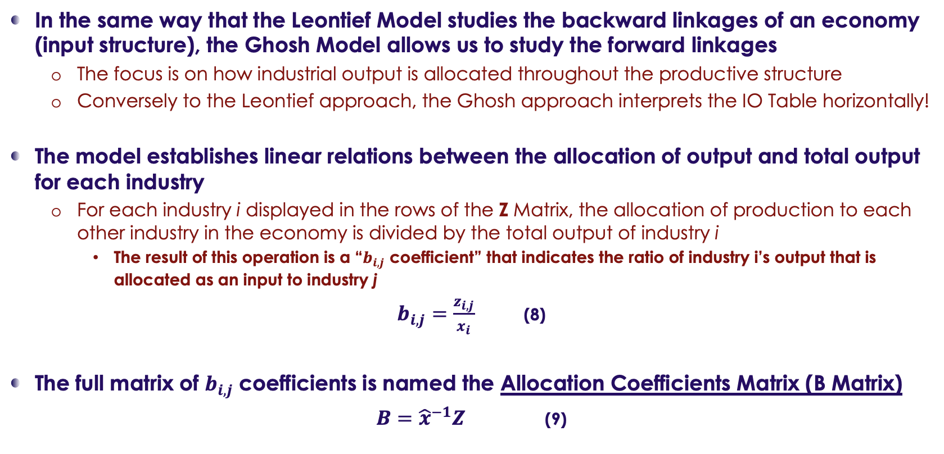
Input-Output Models: Linkages and Multipliers
Allocation Coefficients Matrix (B Matrix)
In the same way that the Leontief Model studies the backward linkages of an economy (input structure), the Ghosh Model allows us to study the forward linkages
The focus is on how industrial output is allocated throughout the productive structure
Conversely to the Leontief approach, the Ghosh approach interprets the IO Table horizontally!
The model establishes linear relations between the allocation of output and total output for each industry
For each industry i displayed in the rows of the Z Matrix, the allocation of production to each other industry in the economy is divided by the total output of industry i
The result of this operation is a “$b_{i,j}$ coefficient” that indicates the ratio of industry i’s output that is allocated as an input to industry j
$b_{i,j}=\frac{z_{i,j}}{x_{i}}$ (8)
The full matrix of $b_{i,j}$ coefficients is named the Allocation Coefficients Matrix (B Matrix)
$B={\hat{x}}^{−1}Z$ (9)

Slide 10
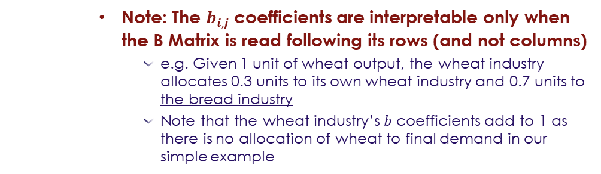
Input-Output Models: Linkages and Multipliers
Allocation Coefficients Matrix (B Matrix)
Let’s go back to our example and calculate its Allocation Coefficients Matrix:
The B Matrix will be calculated as follows:
 | Wheat | Bread | Final Demand | Total Output
Wheat | 30 | 70 | 0 | 100
Bread | 0 | 20 | 180 | 200
Imports | 10 | 10 | 70 | -
Value Added (Factors’ of Production Remuneration) | 60 | 100 | =
Total Output | 100 | 200 |  | 300
Note: The $b_{i,j}$ coefficients are interpretable only when the B Matrix is read following its rows (and not columns)
e.g. Given 1 unit of wheat output, the wheat industry allocates 0.3 units to its own wheat industry and 0.7 units to the bread industry
Note that the wheat industry’s $b$ coefficients add to 1 as there is no allocation of wheat to final demand in our simple example
 | Wheat | Iron
Wheat | 30/100 = 0.30 | 70/100 = 0.70
Iron | 0/200 = 0.00 | 20/200 = 0.10

Slide 11
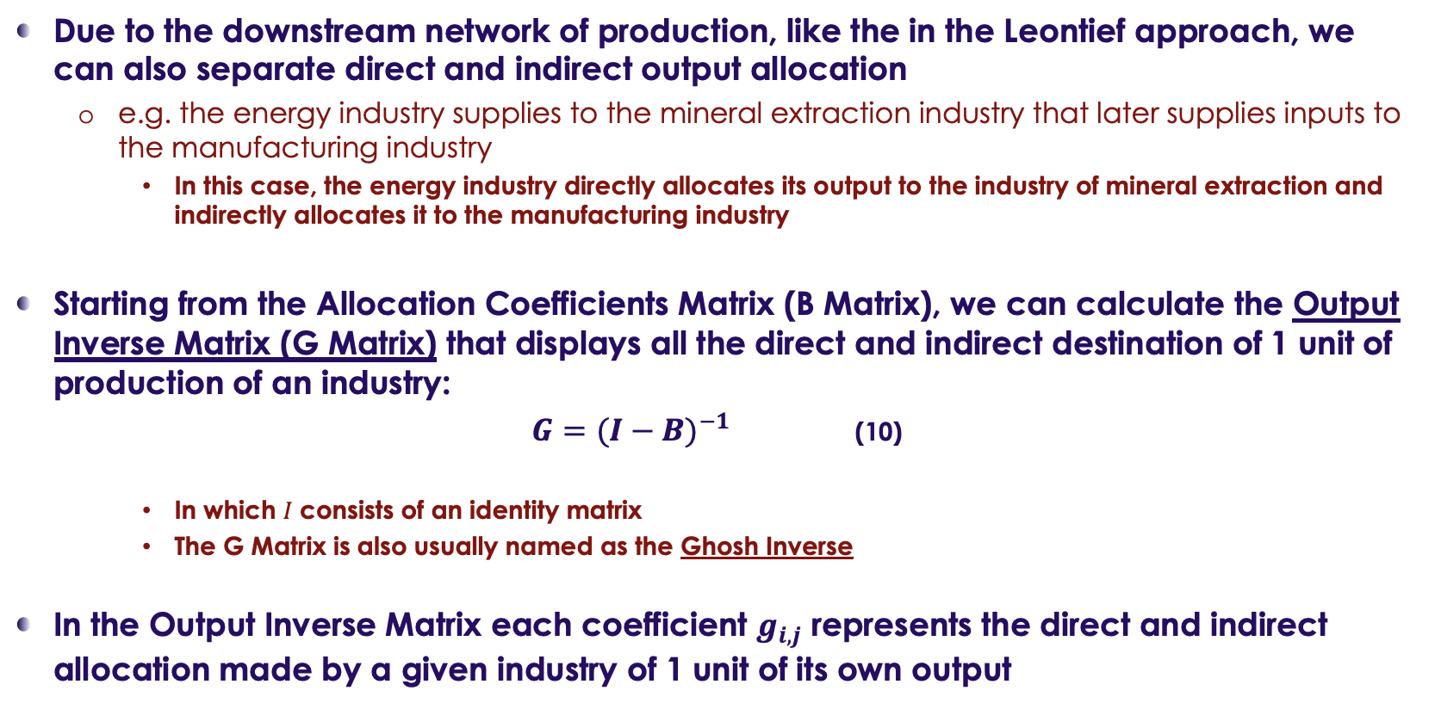
Input-Output Models: Linkages and Multipliers
Output Inverse Matrix (G Matrix)
Due to the downstream network of production, like the in the Leontief approach, we can also separate direct and indirect output allocation
e.g. the energy industry supplies to the mineral extraction industry that later supplies inputs to the manufacturing industry
In this case, the energy industry directly allocates its output to the industry of mineral extraction and indirectly allocates it to the manufacturing industry
Starting from the Allocation Coefficients Matrix (B Matrix), we can calculate the Output Inverse Matrix (G Matrix) that displays all the direct and indirect destination of 1 unit of production of an industry:
$G={(I−B)}^{−1}$ (10)
In which $I$ consists of an identity matrix
The G Matrix is also usually named as the Ghosh Inverse
In the Output Inverse Matrix each coefficient $g_{i,j}$ represents the direct and indirect allocation made by a given industry of 1 unit of its own output

Slide 12
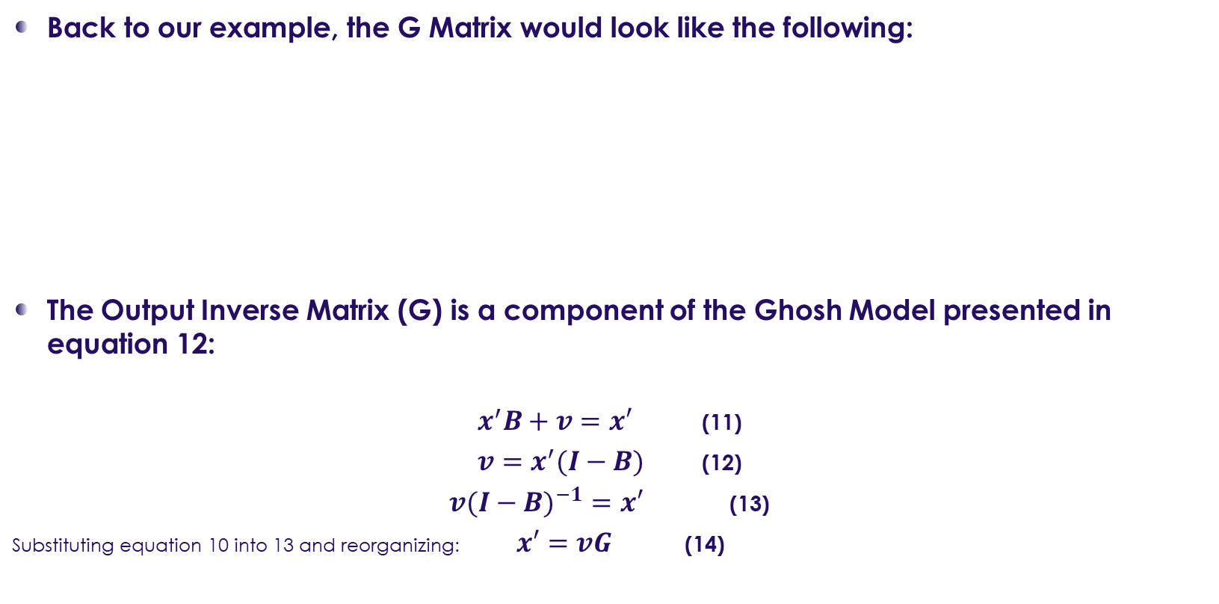
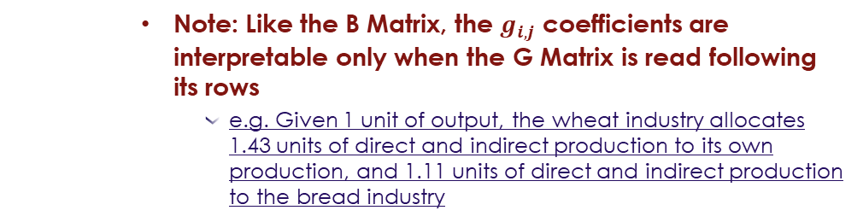
Input-Output Models: Linkages and Multipliers
The Ghosh Model
Back to our example, the G Matrix would look like the following:
The Output Inverse Matrix (G) is a component of the Ghosh Model presented in equation 12:
$x^{′}B+v=x′$ (11)
$v=x^{′}(I−B)$ (12)
${v(I−B)}^{−1}=x′$ (13)
Substituting equation 10 into 13 and reorganizing: $x′=vG$ (14)
 | Wheat | Bread
Wheat | 1.43 | 1.11
Bread | 0 | 1.11
Note: Like the B Matrix, the $g_{i,j}$ coefficients are interpretable only when the G Matrix is read following its rows
e.g. Given 1 unit of output, the wheat industry allocates 1.43 units of direct and indirect production to its own production, and 1.11 units of direct and indirect production to the bread industry

Slide 13
Input-Output Models: Linkages and Multipliers
The Ghosh Model
The Ghosh Model (equation 12) establishes the relationship between value-added and industrial output in an economy
It establishes the amount of industrial output production possible to be produced given the factors of production available (in the value-added vector)
It is a supply-led model by definition
Key assumptions of the Ghosh Model:
Value-added determines total output of the economy
Final demand adapts to output ensuring full employment
Constant returns to scale
Factors of production are substitutable among themselves
The structure of output allocation is fixed

Slide 14
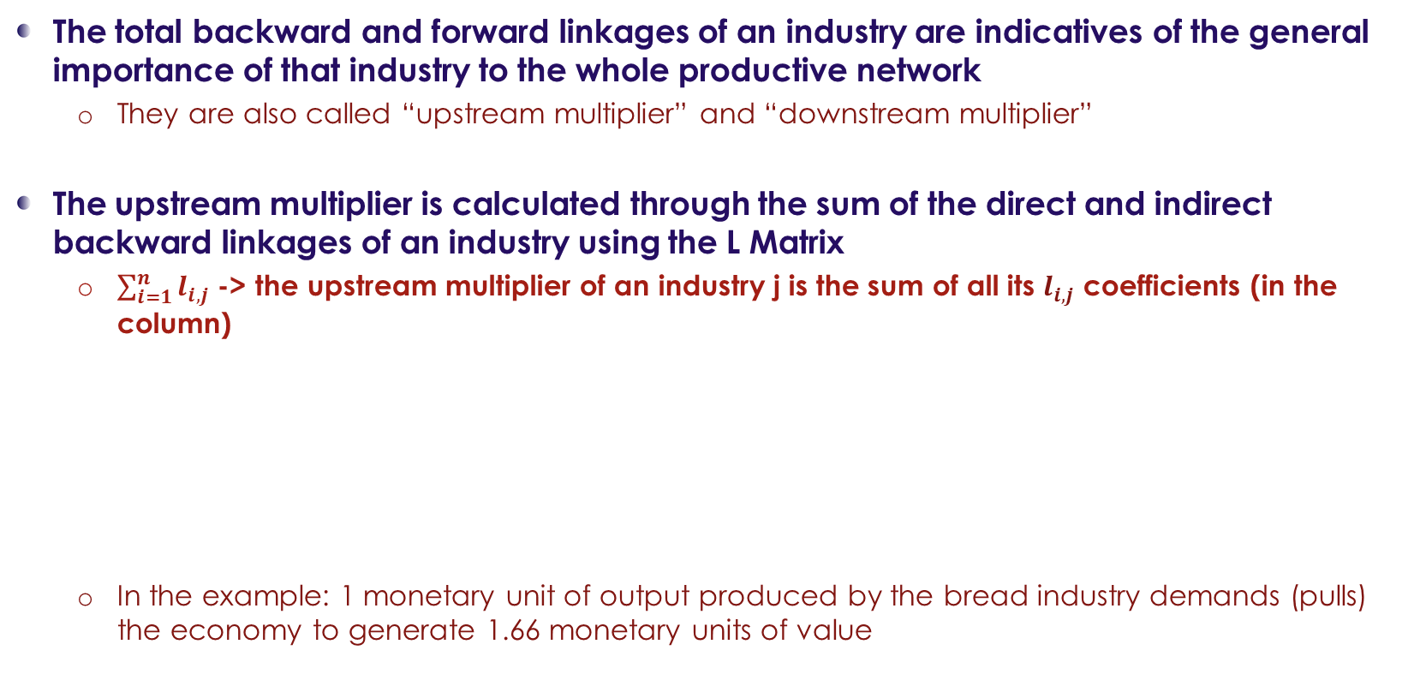
Input-Output Models: Linkages and Multipliers
Multipliers: Backward and Forward Linkages
The total backward and forward linkages of an industry are indicatives of the general importance of that industry to the whole productive network
They are also called “upstream multiplier” and “downstream multiplier”
The upstream multiplier is calculated through the sum of the direct and indirect backward linkages of an industry using the L Matrix
$\sum_{i=1}^{n}{l_{i,j}}$ -> the upstream multiplier of an industry j is the sum of all its $l_{i,j}$ coefficients (in the column)
In the example: 1 monetary unit of output produced by the bread industry demands (pulls) the economy to generate 1.66 monetary units of value
 | Wheat | Bread
Wheat | 1.43 | 0.56
Bread | 0 | 1.11
Backward linkages | 1.43 | 1.66

Slide 15
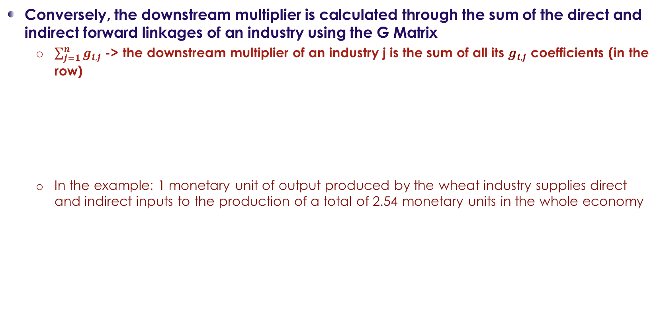
Input-Output Models: Linkages and Multipliers
Multipliers: Backward and Forward Linkages
Conversely, the downstream multiplier is calculated through the sum of the direct and indirect forward linkages of an industry using the G Matrix
$\sum_{j=1}^{n}{g_{i,j}}$ -> the downstream multiplier of an industry j is the sum of all its $g_{i,j}$ coefficients (in the row)
In the example: 1 monetary unit of output produced by the wheat industry supplies direct and indirect inputs to the production of a total of 2.54 monetary units in the whole economy
 | Wheat | Bread | Forward linkages
Wheat | 1.43 | 1.11 | 2.54
Bread | 0 | 1.11 | 1.11

Slide 16
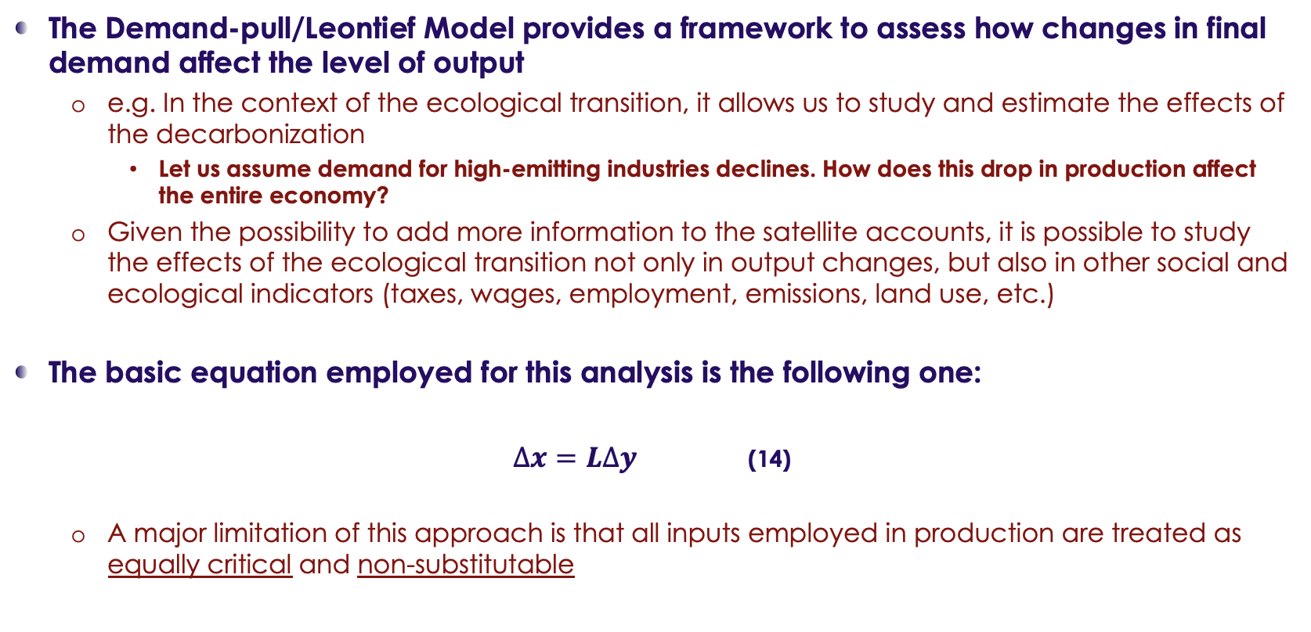
Input-Output Models: Linkages and Multipliers
Changes in Final Demand
The Demand-pull/Leontief Model provides a framework to assess how changes in final demand affect the level of output
e.g. In the context of the ecological transition, it allows us to study and estimate the effects of the decarbonization
Let us assume demand for high-emitting industries declines. How does this drop in production affect the entire economy?
Given the possibility to add more information to the satellite accounts, it is possible to study the effects of the ecological transition not only in output changes, but also in other social and ecological indicators (taxes, wages, employment, emissions, land use, etc.)
The basic equation employed for this analysis is the following one:
$∆x=L∆y$ (14)
A major limitation of this approach is that all inputs employed in production are treated as equally critical and non-substitutable

Slide 17
Input-Output Models: Linkages and Multipliers
An example: WIOD Table for 2010
Once more we invite you now to watch the following videos where we present you a real IO Model using the World Input-Output Database (WIOD) 2013 Release (Timmer et al., 2015)
In the videos we show how to calculate the A, L, B and G Matrices + Multipliers in Excel
Watch the videos here!
The dataset can be downloaded here -> select the option of “National IO tables”
Open the file “BRA_NIOT_ROW_Sep12”

Slide 18
Suggested Readings:
Textbooks and further readings
Textbooks:
Miller, R. E., & Blair, P. D. (2021). Input-Output Analysis: Foundations and Extensions (3rd ed.). Cambridge University Press. https://doi.org/10.1017/9781108676212
Chapters 2 and 7
Raa, T. ten (Ed.). (2017). Handbook of input-output analysis. Edward Elgar Publishing. https://doi.org/10.4337/9781783476329
Chapter 4
Recommended readings:
Altimiras-Martin, A. (2024). A supply-driven model consuming simultaneously all primary inputs: Unfolding analytical potential beyond the Ghosh model. Economic Systems Research, 36(2), 249–264. https://doi.org/10.1080/09535314.2022.2137008
Dietzenbacher, E. (1997). In Vindication of the Ghosh Model: A Reinterpretation as a Price Model. Journal of Regional Science, 37(4), 629–651. https://doi.org/10.1111/0022-4146.00073
Ghosh, A. (1958). Input-Output Approach in an Allocation System. Economica, 25(97), 58. https://doi.org/10.2307/2550694
Oosterhaven, J. (1988). ON THE PLAUSIBILITY OF THE SUPPLY‐DRIVEN INPUT‐OUTPUT MODEL. Journal of Regional Science, 28(2), 203–217. https://doi.org/10.1111/j.1467-9787.1988.tb01208.x
Oosterhaven, J. (1996). Leontief versus Ghoshian Price and Quantity Models. Southern Economic Journal, 62(3), 750. https://doi.org/10.2307/1060892

